Slide 1
Integrative Cases –
DEI and Thematic
Office of Academic Affairs
Willie Miller, Faculty Advancement and Leadership Development Fellow
IUPUI
Notes:
This workshop will discuss key elements of the new Integrative DEI Case, from “integrative” to “diversity.” Particular points of emphasis will be on documenting impact, articulating a DEI philosophy, and identifying supportive evidence. Every case will be unique—be prepared to be flexible and creative within the general outlines of the case criteria.
This workshop is for tenure-track faculty, clinical faculty, lecturer (or teaching)-track faculty

Slide 2
Upcoming Workshops
10 Oct. 2023, 1:00 PM
Zoom, Dossier Preparation, Integrative Cases – DEI and Thematic
13 Oct. 2023, 2:00 PM
CE, Navigating P&T: The Case for Underrepresented Faculty
30 Oct. 2023, 2:00pm
CE, Promotion for Women Session 1

Slide 3
Agenda
Campus definition of the balanced-integrative cases
  Integrative DEI Case
  Integrative Thematic Case
DEI Philosophy and Candidate Statement
Documenting impact
Integrative IUPUI P&T CV
Managing balanced cases
Discussion

Slide 4

Exceptions
School of Medicine
Librarians, kind of
Research Faculty
© The Walt Disney Company
Notes:
For School of Med, the Dean does not allow balanced cases
Research faculty go up on research
Librarians still have a requirement for a performance-excellent case, but they have created a set of guideline that center DEI work as a part of performance

Slide 5
Defining Balanced Cases

Slide 6
Balanced Case
IUPUI P&T Guidelines
IU Policy: ACA-38 Faculty and Librarian Promotions
“In exceptional cases, a candidate may present evidence of balanced strengths that promise excellent overall performance of comparable benefit to the university.”

Slide 7
Balanced-Integrative Cases
IUPUI P&T Guidelines
IUPUI P&T Guidelines: pgs. 20 & 21
“…. the candidate’s activities and accomplishments are interrelated. Individual items need not be labelled or separated as belonging exclusively to teaching, research, or service. However, the candidate should demonstrate how teaching, research, and service are expressed by the items: for example, a particular grant may have both teaching and research aspects or a publication may advance disciplinary knowledge (research) and but also be a result of collaboration with practitioners (service). Candidates will state their integrative philosophy and show how their most important accomplishments demonstrate peer-evaluated impact and quality.”

Slide 8
Balanced-Integrative DEI Case
Balanced-Integrative DEI Case
The candidate demonstrates excellence across an array of integrated scholarly activities aligned with diversity, equity, and inclusion (“comparable” to a single-area-of-excellence case)
To associate: Candidate will have led or been an essential part of endeavors with distinct and demonstrable local outcomes. Local refers to either or both of campus/university and local community. National or international dissemination is also expected as a reflection of the quality of work.
To full: The candidate will be seen as a local leader and will also have achieved a national or international reputation through their work.

Slide 9
Excellence in an Integrative DEI Case
Balanced-Integrative DEI Case
The following must be evident, using multiple sources of information:
Evidence of at least satisfactory performance in teaching, research/creative activity, and service.
A philosophy/statement of diversity, equity, and inclusion, including if appropriate any specifically targeted aspect.
Interrelated activities and accomplishments as an IUPUI faculty member in teaching, research, and service which demonstrably support and advance DEI.
Independence, innovation, and initiative: Description of the candidate’s personal role as an essential and generative actor within diversity initiatives.

Slide 10
Excellence in an Integrative DEI Case
Balanced-Integrative DEI Case
Scholarly impact: Often but not exclusively facilitated by peer-reviewed dissemination; ; a variety of venues for dissemination are accepted.
Direct Impact: Effective evaluation of diversity, equity, and inclusion initiatives should demonstrate distinct outcomes. Tying to unit (program, department, school, campus, or university) missions strengthens the importance of the impact (e.g., contributing to a local community’s using professional expertise, recruiting diverse students to undergraduate or graduate programs, diversifying curricula, etc.
Increasing development over time. A candidate’s statement should describe future plans.

Slide 11
Integrative Thematic Case
Balanced-Integrative Thematic Case
IUPUI P&T Guidelines name three additional areas with “should have that work acknowledged and rewarded in the review process” (Institutional Values)
Civic engagement
Translational research
Teaching related: Honors College; Profiles of Learning for Undergraduate Success, RISE to the IUPUI Challenge/Experiential Learning, University College.
Balanced-Integrative cases may address one of these values as their philosophy, but this list is not exhaustive.
The strongest cases will be tied to unit missions and goals.
Schools and departments may develop templates and expectations for themes particularly relevant to their units.

Slide 12
Excellence in an Integrative Thematic Case
Balanced-Integrative Thematic Case
Evidence of at least satisfactory performance in teaching, research/creative activity, and service.
A clearly articulated philosophy / defined theme which is reflected in the interrelated activities across teaching, research/creative activity, and service.
Independence, innovation, and initiative: The candidate articulates their personal role as an essential and generative actor within diversity initiatives. Interdependence and teamwork are valued as well as contributions to group achievements; the candidates need to describe their own roles and responsibilities.

Slide 13
Excellence in an Integrative Thematic Case
Balanced-Integrative Thematic Case
Independence, innovation, and initiative
Scholarly and direct impact and demonstrated quality. Academic peer review is required as a component of assessing scholarly (research, creative activity) impact; professional or academic peer review as well as other indicators of quality and impact would support assessments of teaching- and service- oriented activities.
A cumulative record that supports an argument for overall excellent contribution to the unit and university.
Increasing development over time. A candidate’s statement should describe plans for the future.

Slide 14
Strong balanced cases include
Scholarly products in each area
Visibly more than merely satisfactory
A coherent integration across areas
Intentionality
Overall benefit to the University, tied to the unit’s mission

Slide 15
DEI Philosophy and Candidate Statement

Slide 16
Candidate statement: states your case
You present your accomplishments and your future plans
5-7 pages (single-spaced; regular margins)
  7-pages: Integrate your philosophy/statement on DEI into narrative
  5 and 2-pages: Use the 2-pages for your philosophy/statement
Additional details or explanations go in the rest of the dossier

Slide 17
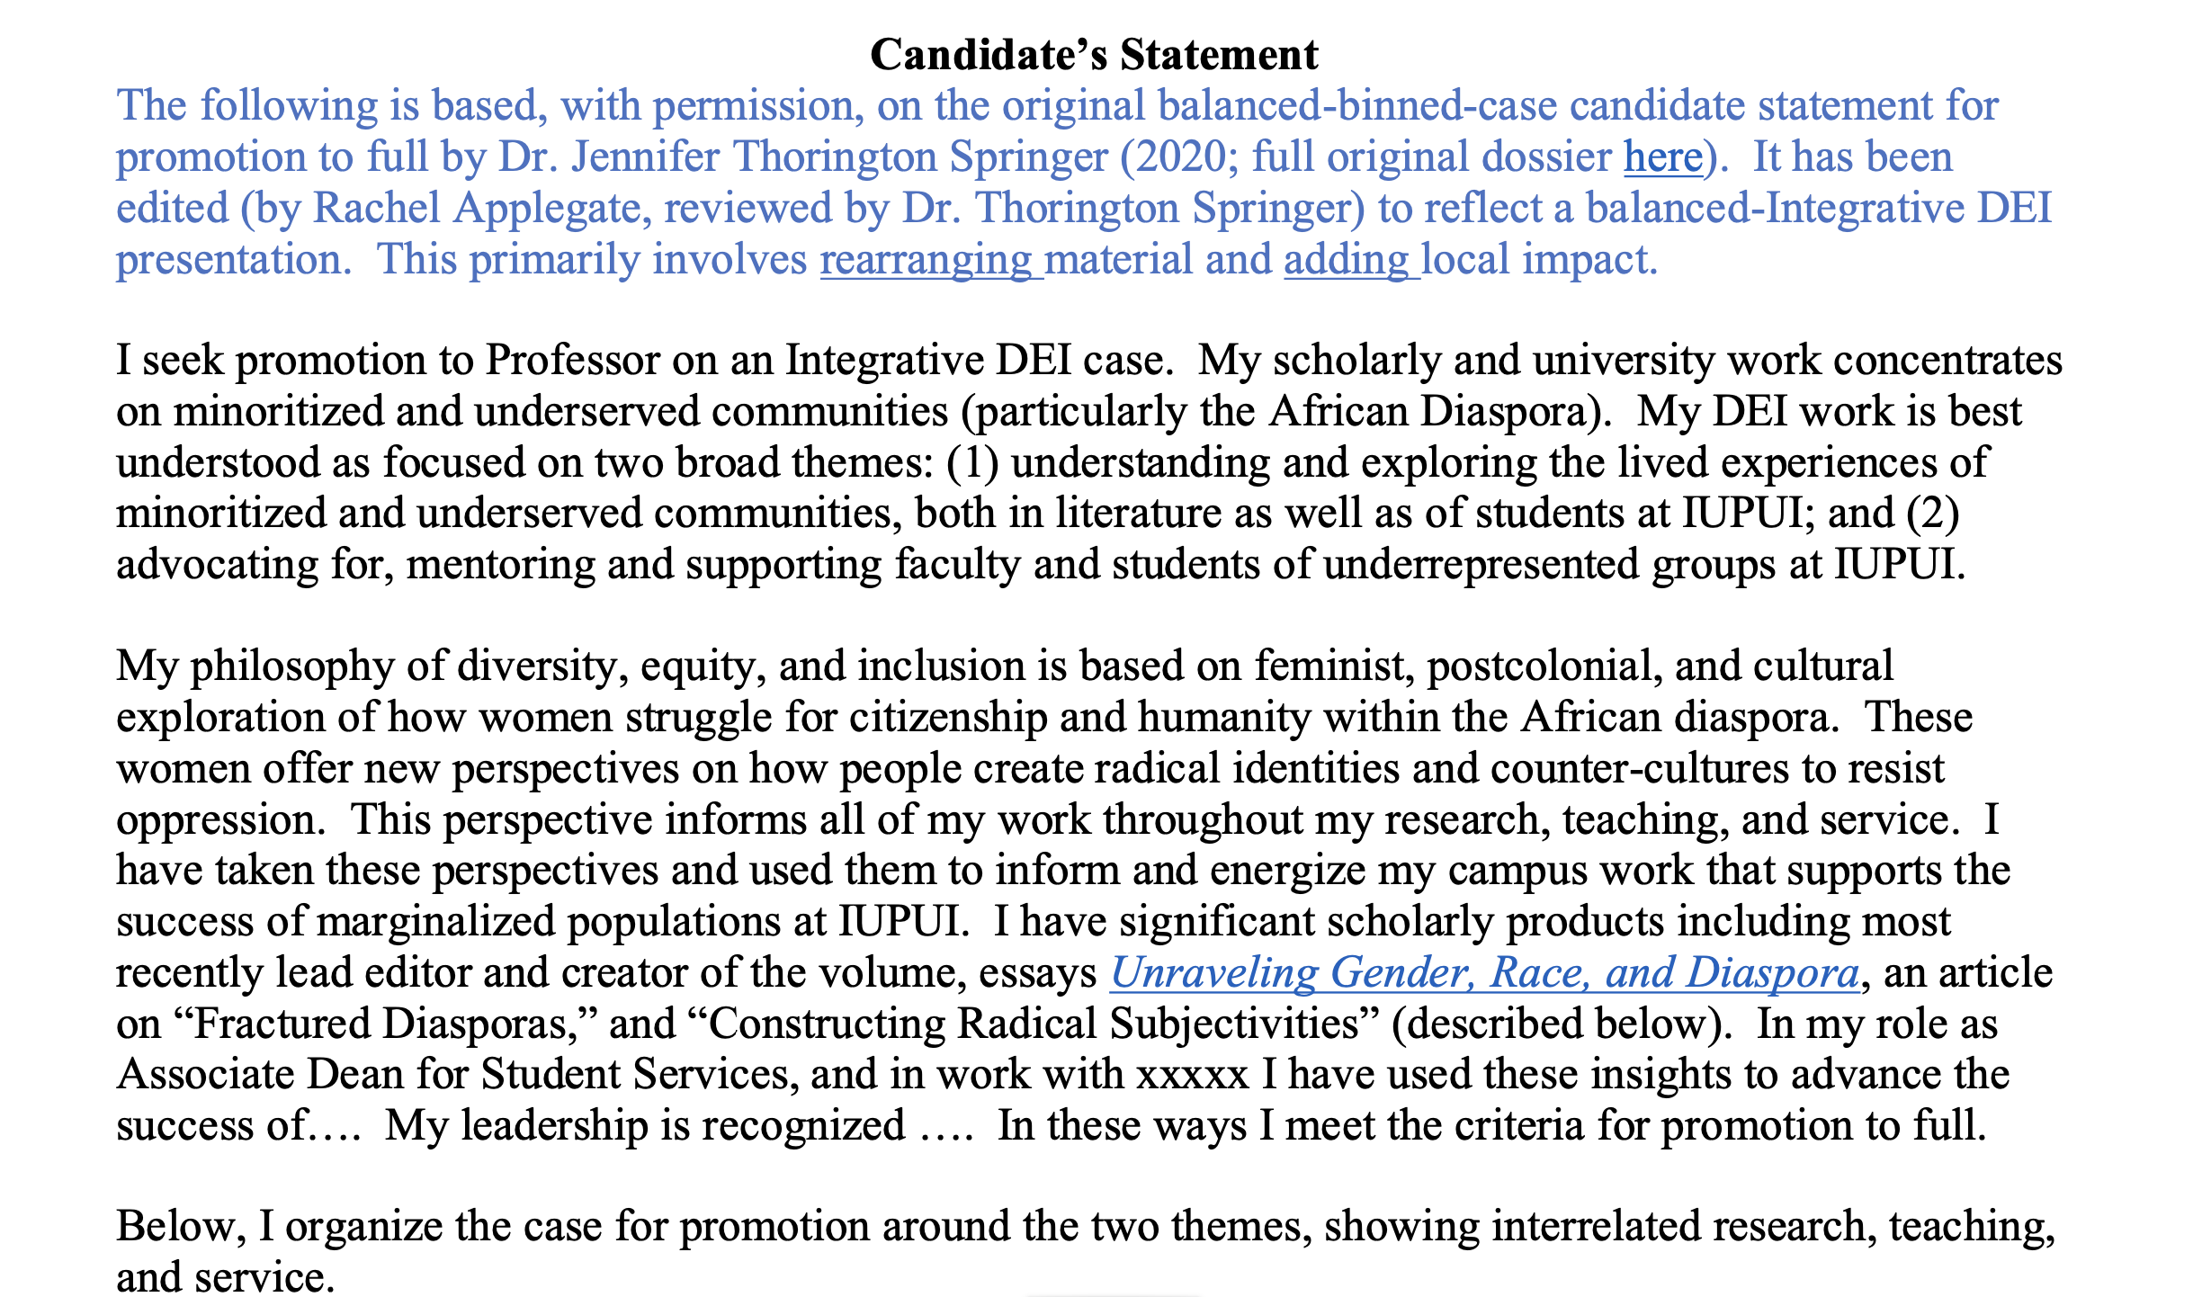
Based on a True Story:
Sample Candidate Statement
Read the full sample
Notes:
7-pager, full rank

Slide 18
Sample Candidate Statement
Read the full sample
Clarifies the rank sought and case type
Identifies the focus of direct impact
Organizes the narrative

Slide 19
Sample Candidate Statement
Read the full sample
Two-sentence philosophy that is referred to and expanded upon with the narrative themes
Briefly describes approach with DEI work
Immediately connects approach to disciplinary engagement (Research) and service to unit (Service)
Notes:
1. My scholarly articles and edited collections in rank have illuminated the lived experiences of minoritized and underserved communities.

Slide 20
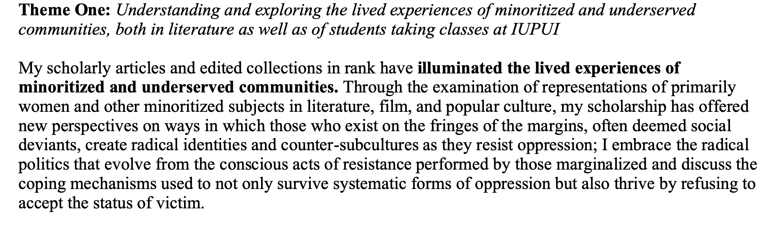
Sample Candidate Statement
Read the full sample
Opens first theme by expanding DEI philosophy within disciplinary context
Highlights focus of DEI-connected scholarship
Following paragraphs provide specific examples connected to scholarship, course development, teaching, and professional service
Notes:
1. My scholarly articles and edited collections in rank have illuminated the lived experiences of minoritized and underserved communities.

Slide 21
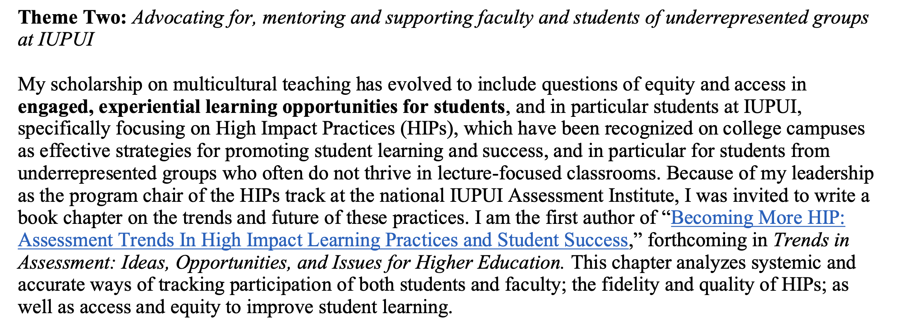
Sample Candidate Statement
Read the full sample
Opens second theme highlighting the focus of local DEI work
Connects to campus goals on HIPs
Shares dissemination of DEI work
Following paragraphs provide specific examples connected to administrative service and mentorship
Notes:
1. My scholarly articles and edited collections in rank have illuminated the lived experiences of minoritized and underserved communities.

Slide 22
Documenting Impact

Slide 23
5 Attributes to Show Significance
Scope (size)
Difficulty/Challenge
Innovation/Creativity
Success/Outcomes
Adoption by others

Slide 24
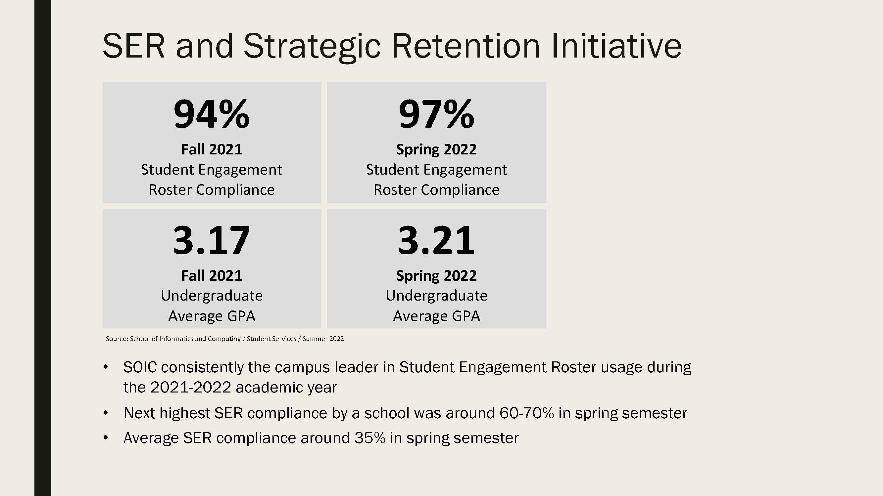
SOIC Example:
Student Engagement Roster
SOIC Examples of Direct Impact Measurements

Slide 25
Quality and Impact: Evidence
Balanced-Integrative DEI Case
Policy work: work that supports adoption of DEI-enhancing governmental or organizational policies and practices.
Grants: securing grants for IU/IUPUI/unit programs for DEI, e.g., funding diverse junior researchers, pipeline initiatives; internal or external.
Grants-assistive work: work that assists either IU/IUPUI-units or community organizations to secure grants to support DEI goals.

Slide 26
Quality and Impact: Evidence
Balanced-Integrative DEI Case
Mentorship/advising: designing a mentoring program; serving as a mentor
Innovative DEI-related curriculum design and delivery
Providing professional development related to DEI
Inclusive teaching practices
Notes:
serving as a mentor (junior colleagues, current or prospective students with impact on DEI; advising groups or individuals)

Slide 27
The dissemination requirement
”Dissemination” varies by type of activity and by discipline: conference presentations, websites/resources, books, articles.
“Peer-reviewed” means, not just the participants in an activity, or recipients of services, but scholarly/academic peers.
Candidates must have at least some peer-reviewed dissemination, but other forms of dissemination are also acceptable
Notes:
Dissemination can include items like professional standards

Slide 28
For tenure-track faculty
Type of case | Dissemination Requirement
Excellence in | Teaching | Research | Service
Teaching | X | X | --
Research | -- | X | --
Service | -- | X | X
Balanced case- binned | X | X | --
Balanced- Integrative | peer-reviewed scholarship required, need not be binned
Binning: for grants, presentations, and publications, each one is designated with one “area” in teaching, research, or service.

Slide 29
Document Your Impact
For both traditional and non-traditional forms of dissemination (everything besides journal articles with citation indexes), librarians can help you make it count.
They will show you how to preserve it for future retrieval and boost citations (ScholarWorks)
They will help you document impact (Research Metrics)

Slide 30
Integrative IUPUI P&T CV

Slide 31
DMAI Method
Generate a course/teaching listing using Rapid Reports
Generate an Integrative IUPUI P&T CV using Rapid Report
Delete the course listing in the Integrative CV and paste in the Courses report
Fine tune as needed

Slide 32
Non-DMAI Method
Generate a course/teaching listing using Rapid Reports
Use other systems to generate lists of:
  Grants: use DMAI or the IU grants management system. Include PI name, grant name, funder, your status, grant total, your amount (if different), begin and end dates, and percent effort (if applicable)
  Professional development: Activities you have attended. Presentations you have provided yourself as the instructor are listed either as presentations or as non-course teaching items.
Paste courses, grants, and professional development into a disciplinary CV
Fine tune as needed

Slide 33
Fine Tuning
Add any notations that are useful for items: *for in-rank, # for DEI-related items, and dagger for student co-authors. If you use other notations, explain them for the reader. You may, but do not need to, indicate if some items are particularly relevant to teaching (T), research (R/CA), or service (S)
Include items that are projects rather than publications—find an appropriate place and describe them the way they would appear in a work resume
Check the grants listing: this will auto-load with any IU-managed grants. Add any if needed
Delete any extra wording or instructions
Include links to sites/electronic materials if available
Must be uploaded as a PDF within eDossier

Slide 34
New! CV Formatter
Requires 3 things:
The Courses report from DMAI
Listing of grants from DMAI or GMT
Regular, up-to-date disciplinary CV

Slide 35
Managing balanced cases
Balanced cases are unusual and unique. OAA and your school are happy to give you individual advice.

Slide 36
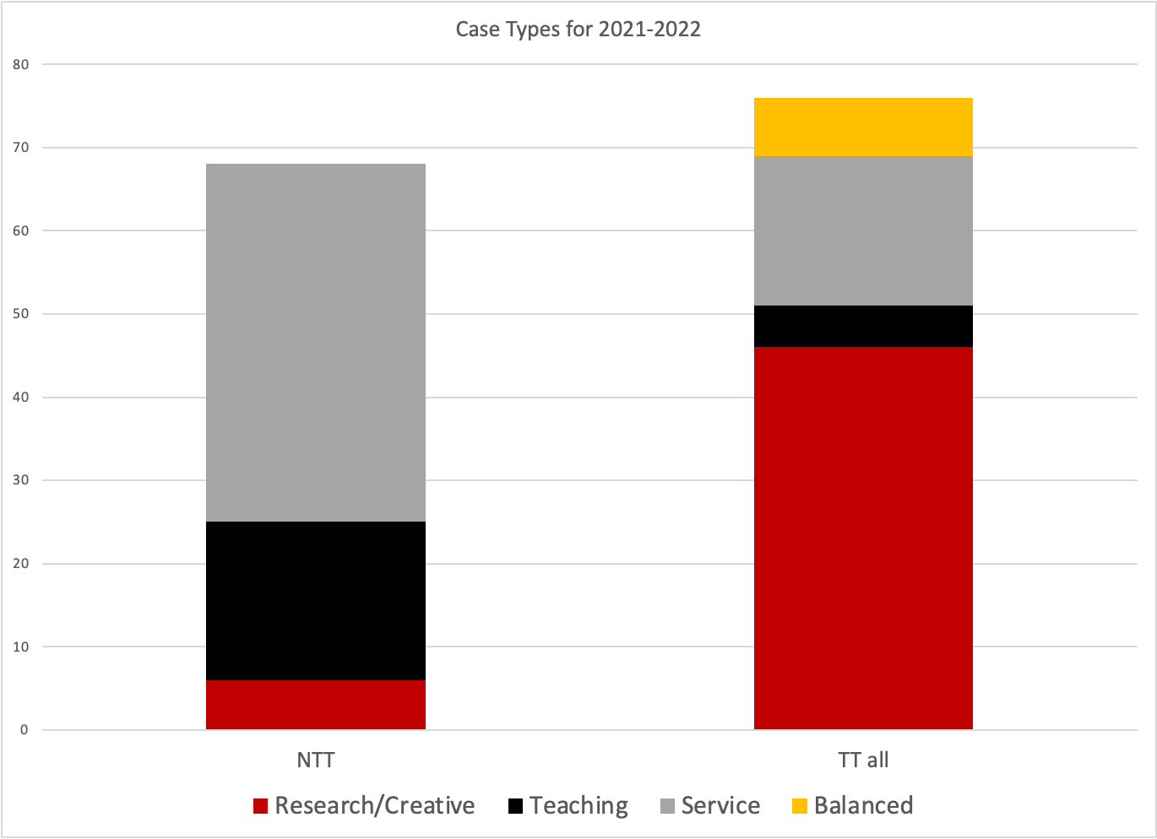

Slide 37
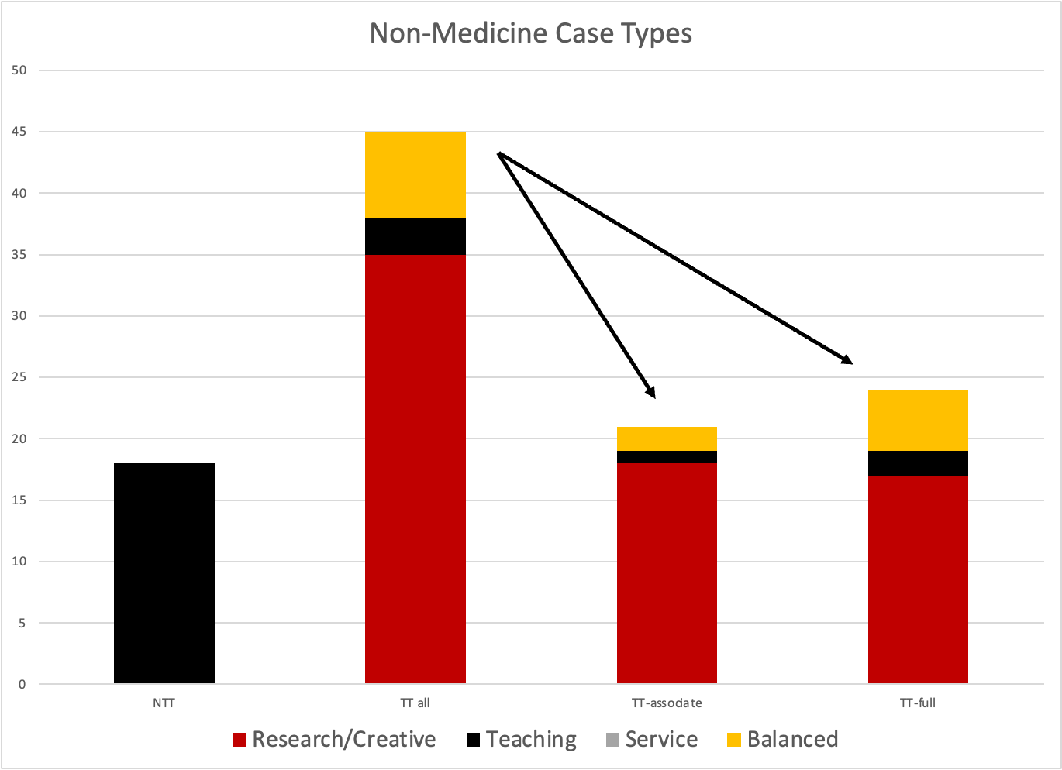
Notes:
2 TT-Associate, 5 TT-Full

Slide 38
An Unusual Case
Balanced case is not discouraged by the campus
Balanced cases are treated carefully – as all are – by the campus committee
A balanced case is not automatically an “all-read” (problem) case
Most of your readers have most of their experience with research cases.
You must educate, explain, and enthuse.

Slide 39
External reviewers and other people to provide input
External reviewers must be:
Academics. One or two might be non-academics, but the chair needs to make a strong specific case for their expertise in evaluating scholarly value.
At the desired or higher rank; at a comparable or higher institution
Not co-authors, co-PIs, or mentors
Able to review and evaluate the candidate’s work; they do not need to be experts in all aspects.
Margie Ferguson and Rachel Applegate can help chairs brainstorm reviewers

Slide 40
External reviewers and other people to provide input
Chairs can solicit other letters:
These letters go into a special non-candidate folder. They are more valuable than candidate-solicited letters, but less than external reviewers.
Especially valuable for work when there are limited formal publication products
Clients and partners in projects can provide their perspectives
Especially appropriate for experts who are not academics

Slide 41
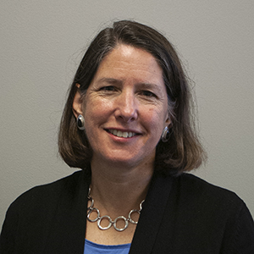
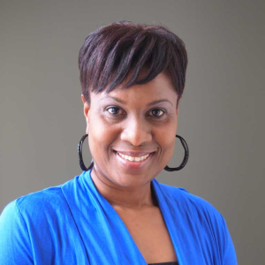
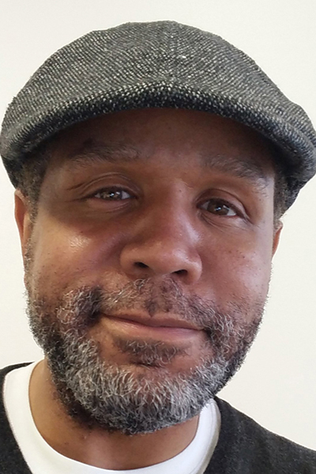
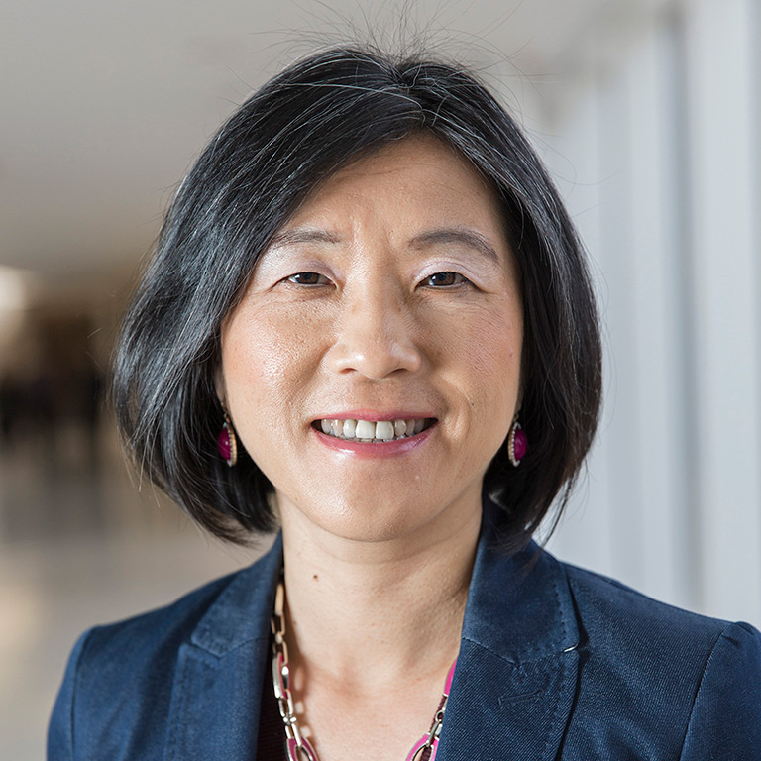
Success Stories
Sample Dossiers on OAA Website
Elizabeth Kryder-Reid, School of Liberal Arts, Balanced-binned. Evidence Grid
Jennifer Thorington-Springer, School of Liberal Arts, Balanced-binned. Dossier (strongly connected to DEI Integrative Case)
Lasana Kazembe - School of Education, Balanced-Integrative (DEI). Excellent philosophy statement.
Lin Zheng - Kelley School of Business, Balanced - Integrative (Theme: Global Learning). Excellent integration across candidate statement.

Slide 42
Resources
Guide to Preparing and Reviewing Integrative Cases
Creating a Balanced-Integrative eDossier
Sample Integrative DEI Candidate Statement
Creating an Integrative IUPUI P&T CV
SOIC Example of Direct Impact Measurements
CV Formatter

Slide 43
Willie Miller
Faculty Advancement and Leadership Development Fellow
wmmiller@iupui.edu
Rachel Applegate
Assistant Vice Chancellor for Faculty Affairs
rapplega@iupui.edu
Margie Ferguson
Senior Associate Vice Chancellor for Academic Affairs
mferguso@iupui.edu

